Slide 1
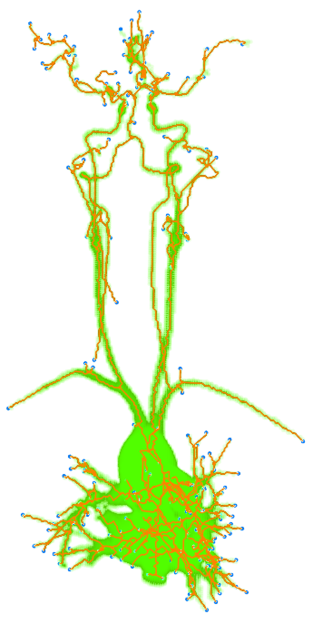
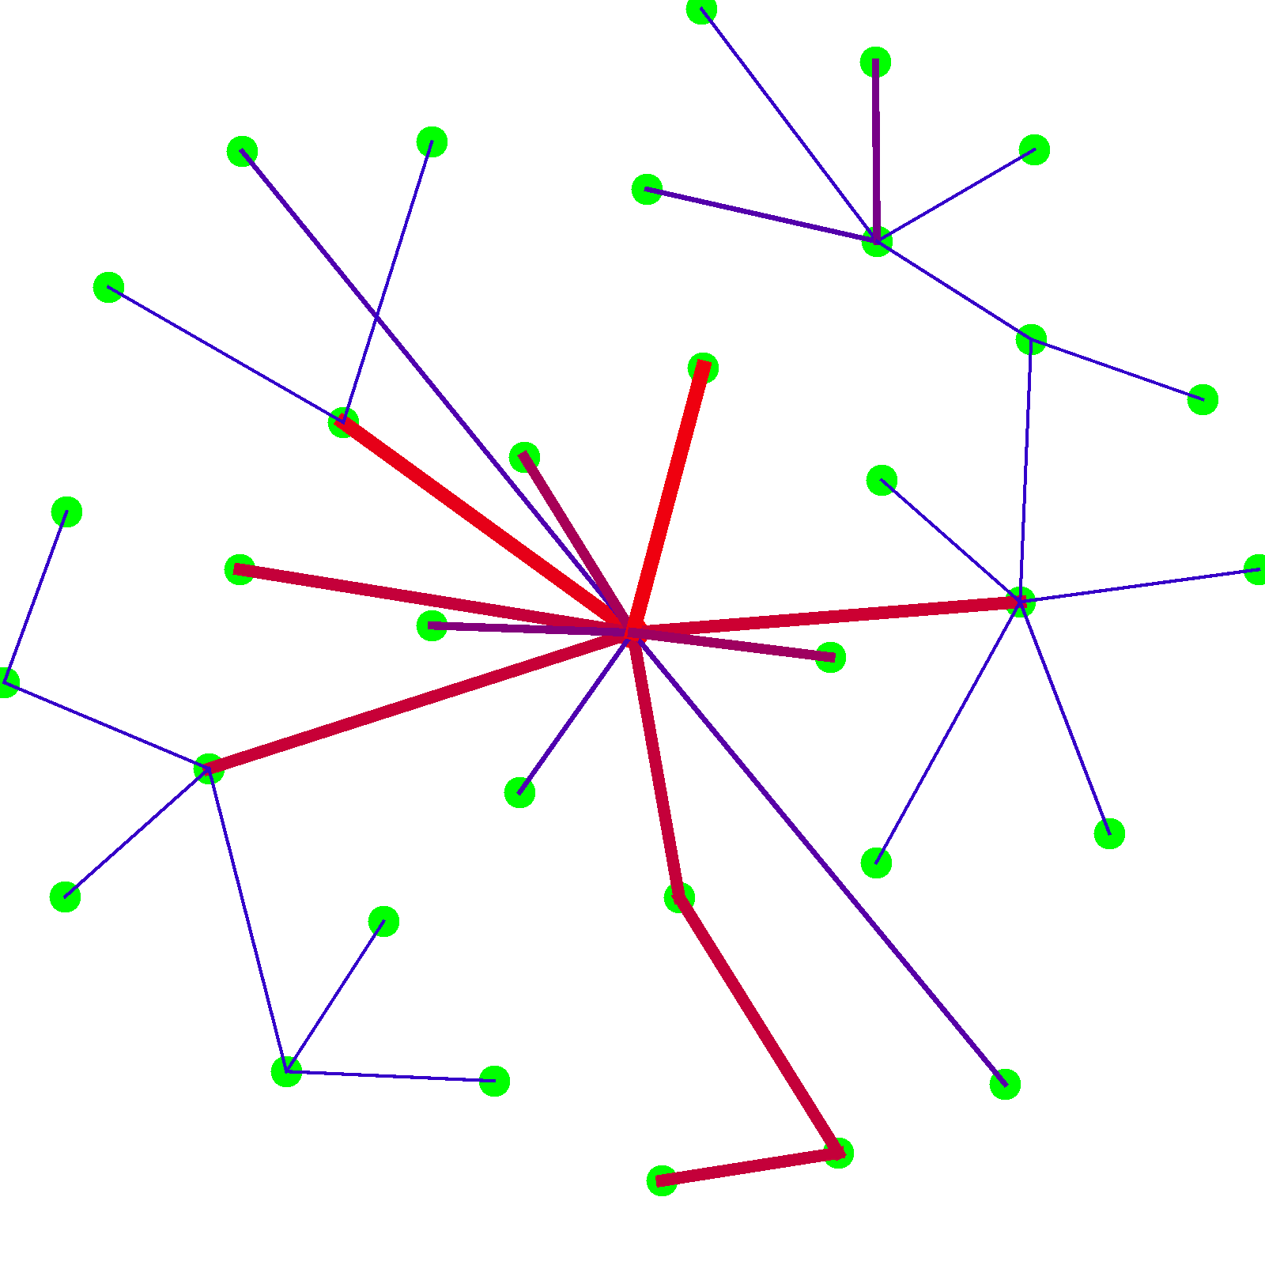
Testing Vascular Structure Modelling Principles by Generating Virtual Vascular Networks
Panagiotis Lymperopoulos
Savage Lab

Slide 2
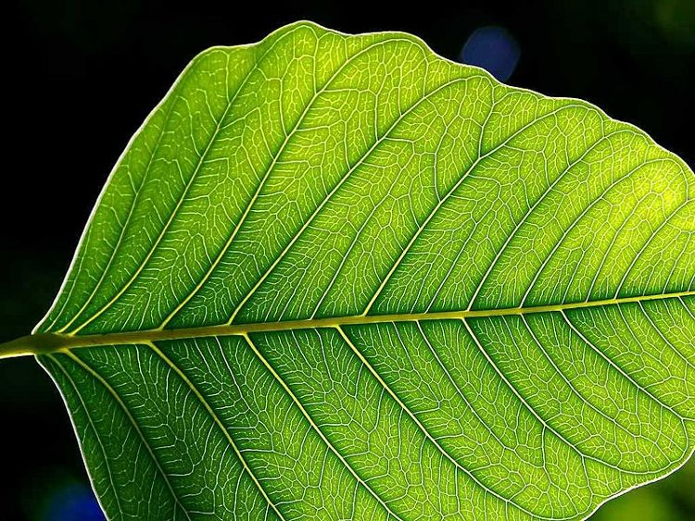
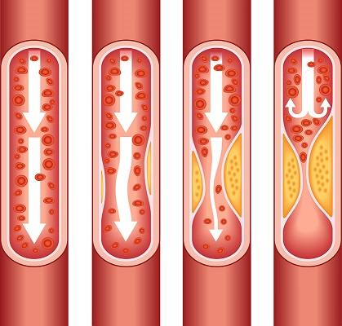
Why study Vascular Networks?
cdc.gov
Multicellularity
1 in every 4 deaths in US
Are due to heart disease

Slide 3
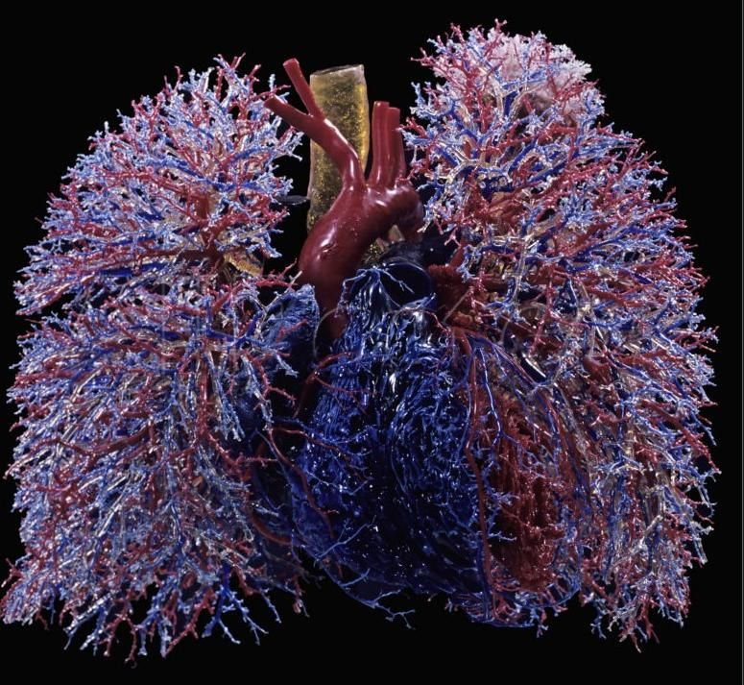
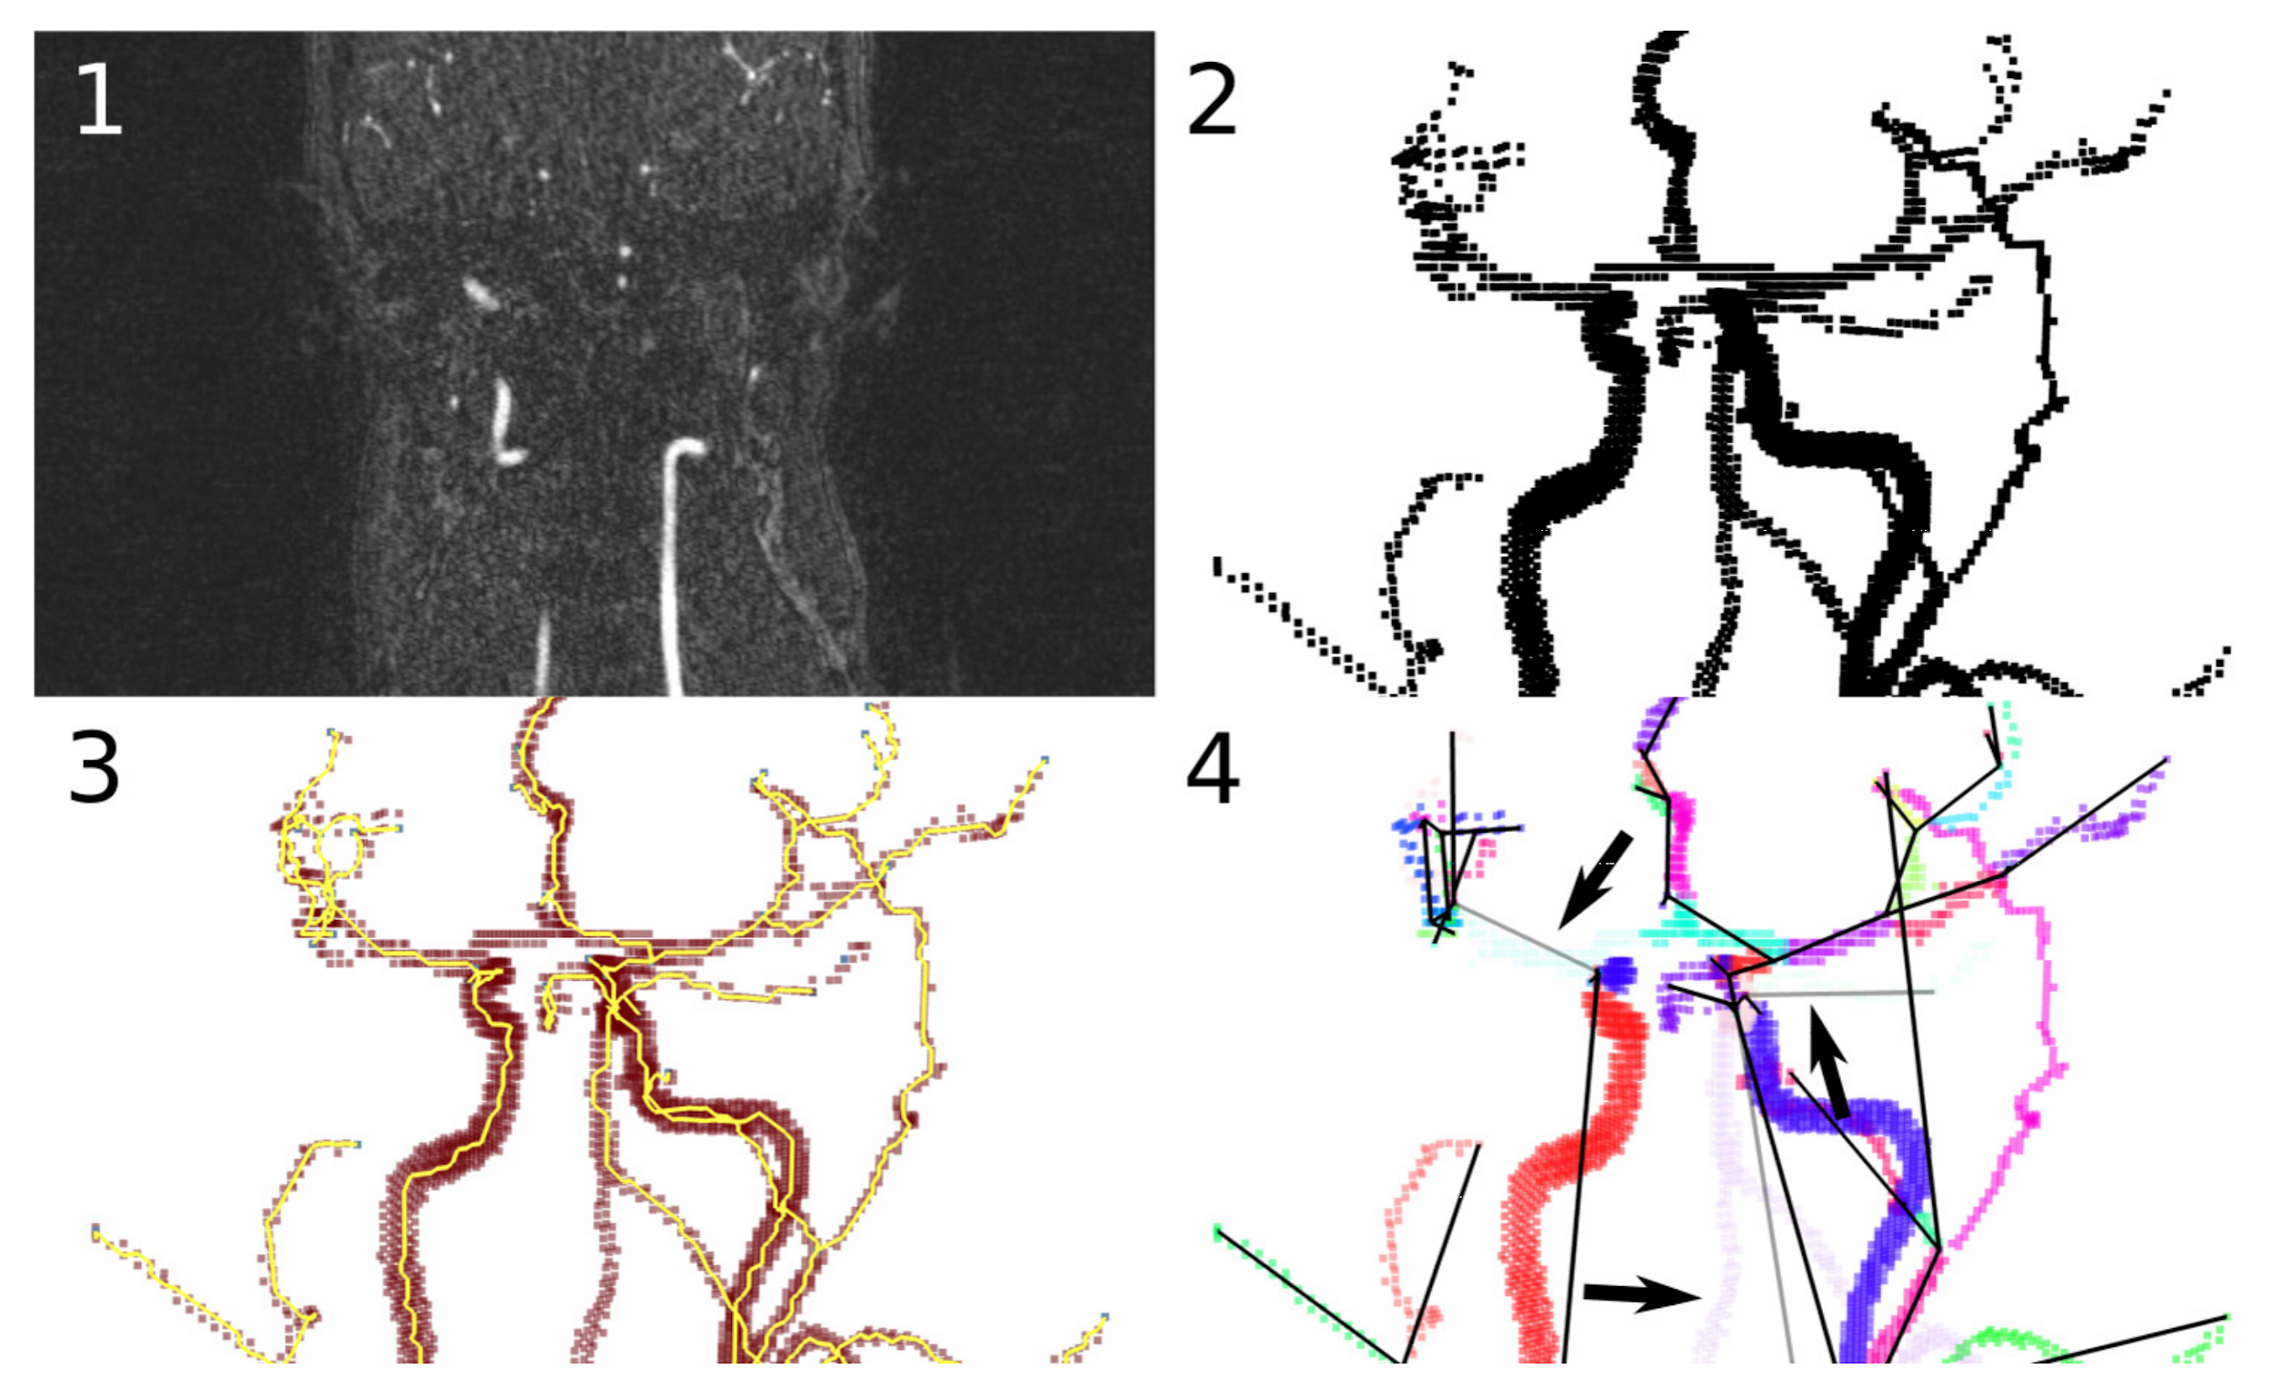
Vascular Data Collection
Mitchell G Newberry , Daniel B Ennis , Van M Savage
Advances in radiomics → Influx of vascular data
But what to do with it?
Maybe broader statement on extent of vascular networks role in the body - branches throughout; carries blood, o2, etc idk.
→ therefore, structure of vascular networks might be indicative of diseased vs. healthy states
Talk about recent extraction of vascular structure (what you just said)
Why we need math to describe it

Slide 4
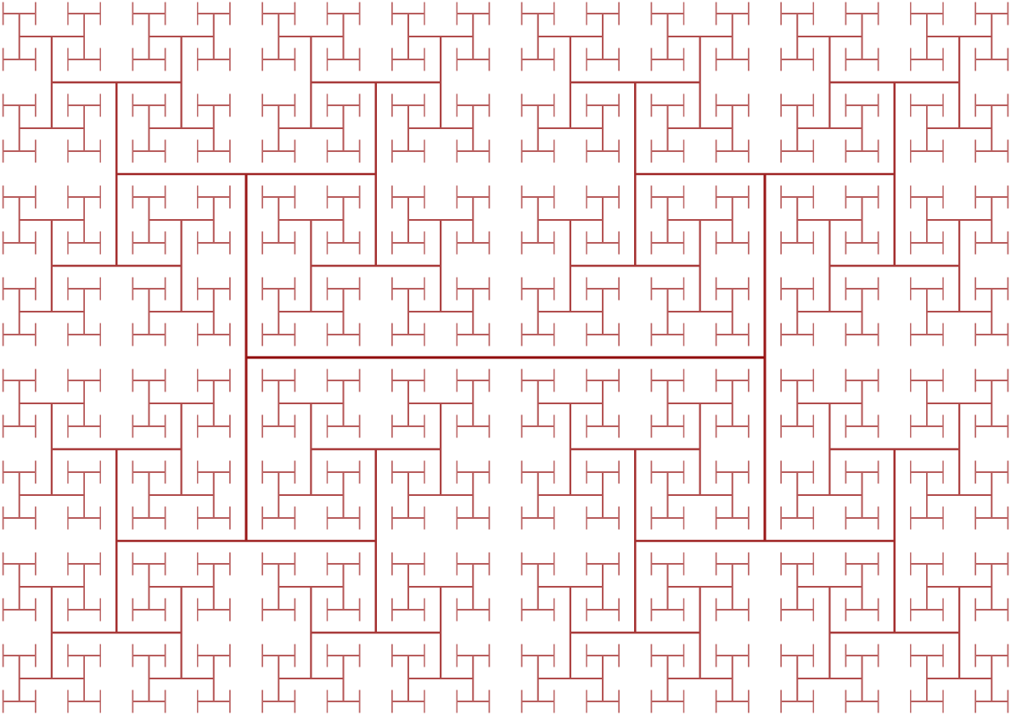
Vascular Modelling Principles
Space-filling
Energy loss minimization
Building cost minimization

Slide 5
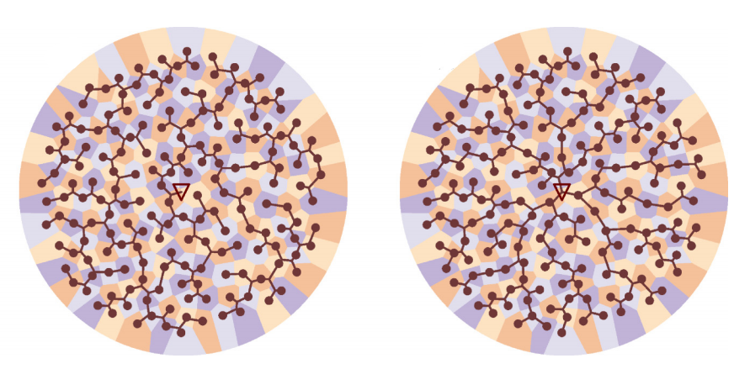
Previous work
Hunt and Savage (2016) attempt to generate virtual vascular networks by considering only vessel lengths

Slide 6
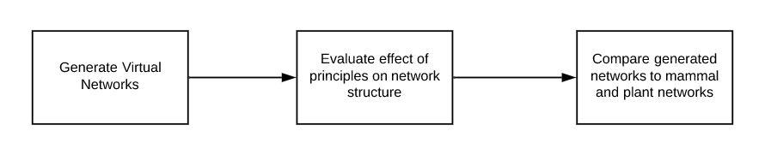
Research Question
Are the principles of energy loss minimization, space-filling and building cost minimization valid and sufficient to produce realistic vascular networks?

Slide 7
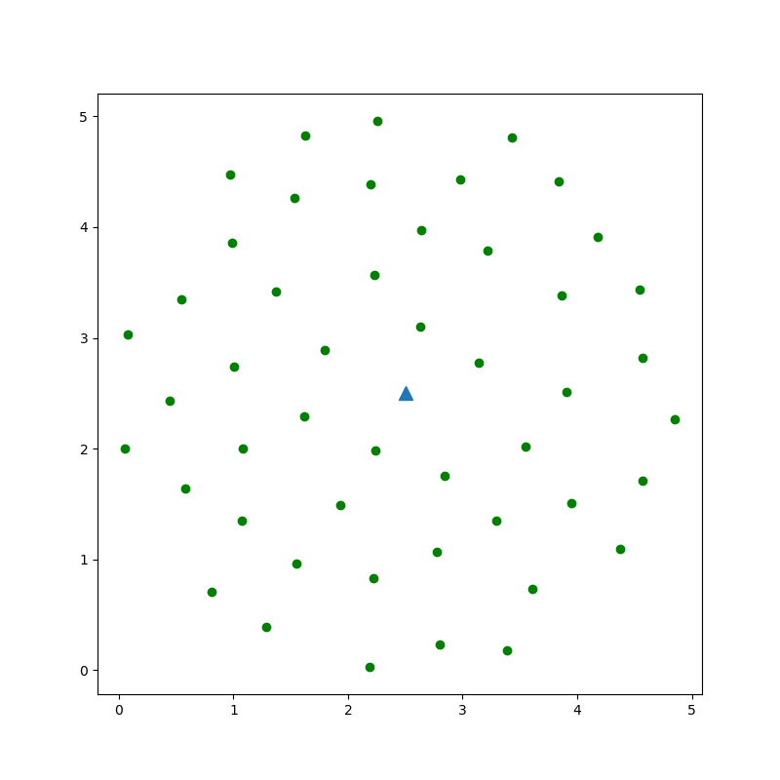
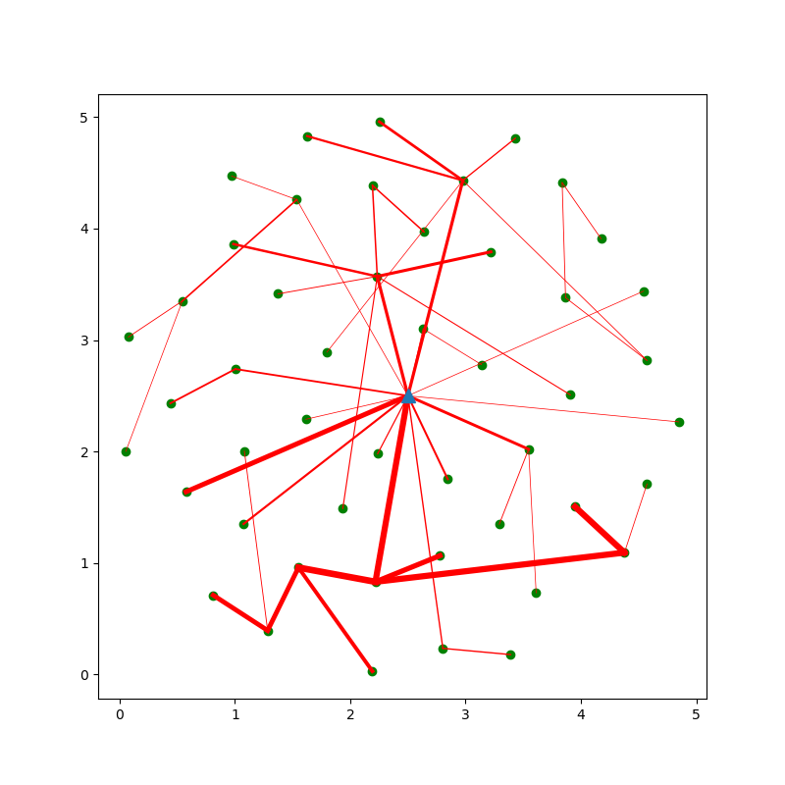
Virtual Vascular Network Generator
Optimize a population of vascular networks for a combination of network metrics using Genetic Algorithms.
Networks “fill space” by delivering to a predetermined set of “service areas” that are distributed on a circular plate.

Slide 8
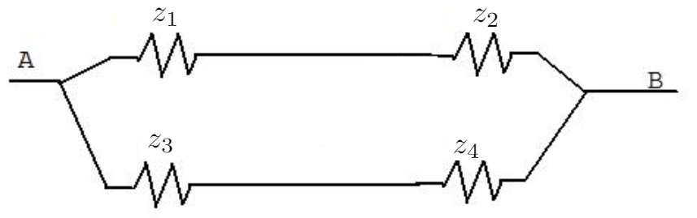
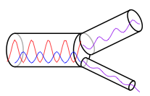
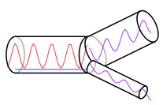
Optimization Criteria
Energy Loss Cost
Energy Dissipation (friction)
Wave reflections
Building Cost
Material cost
Resource delivery efficiency

Slide 9
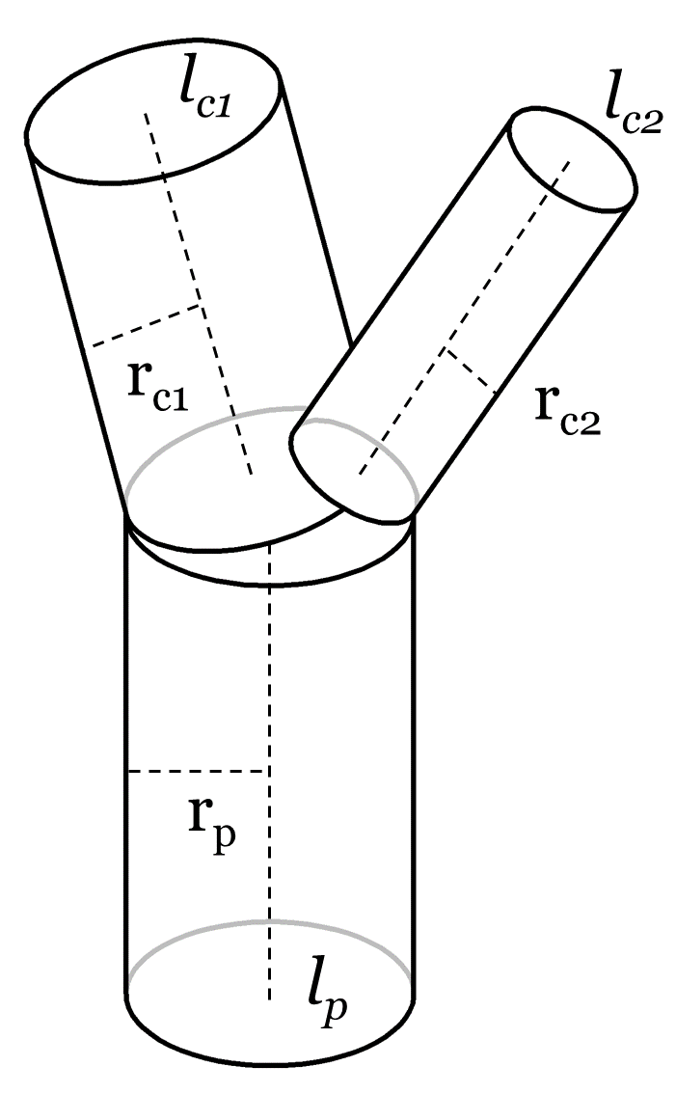
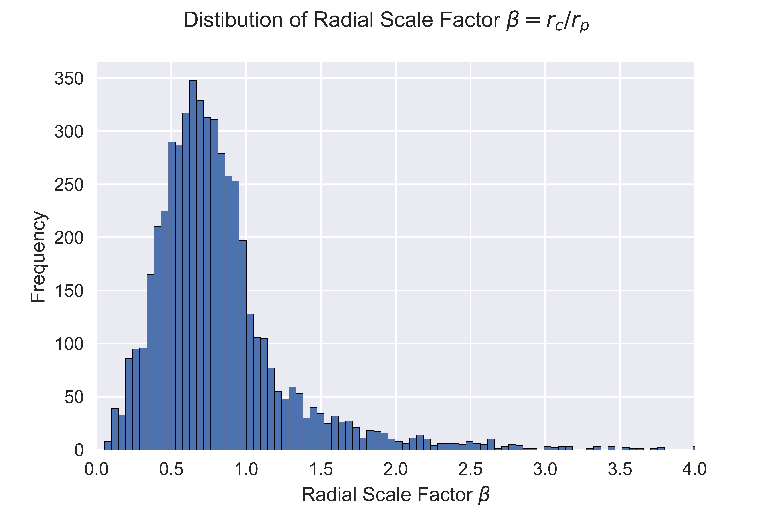
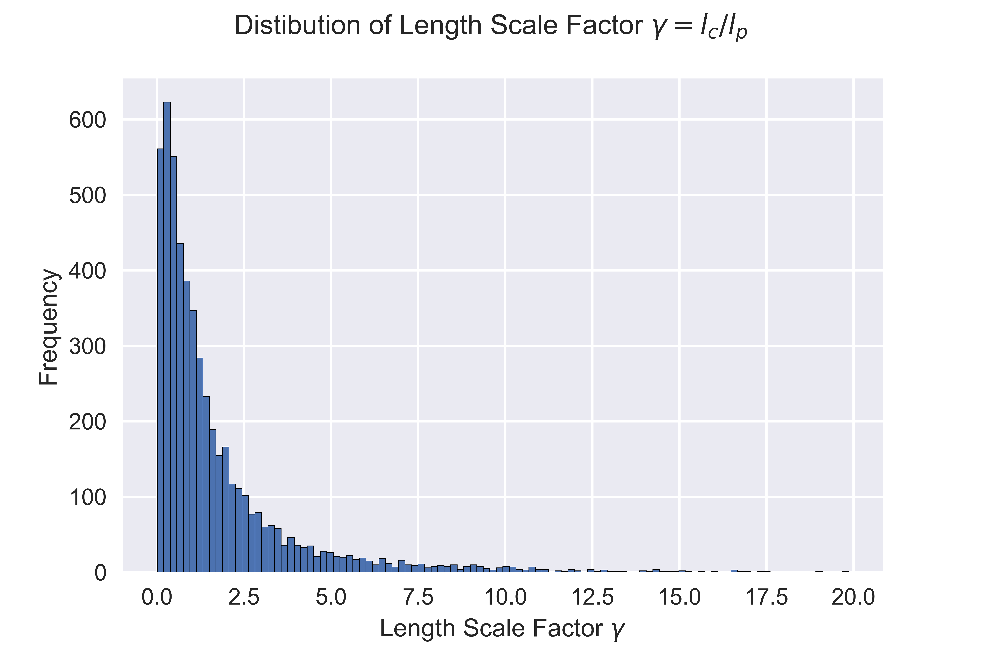
Quantifying Network Scaling Properties
Distribution of β = r_{c1} / r_{c2}
Distribution of γ = l_{c1} / l_{c2}
Compare generated networks with mammal and plant networks using Welch’s t-test on the β and γ distributions

Slide 10
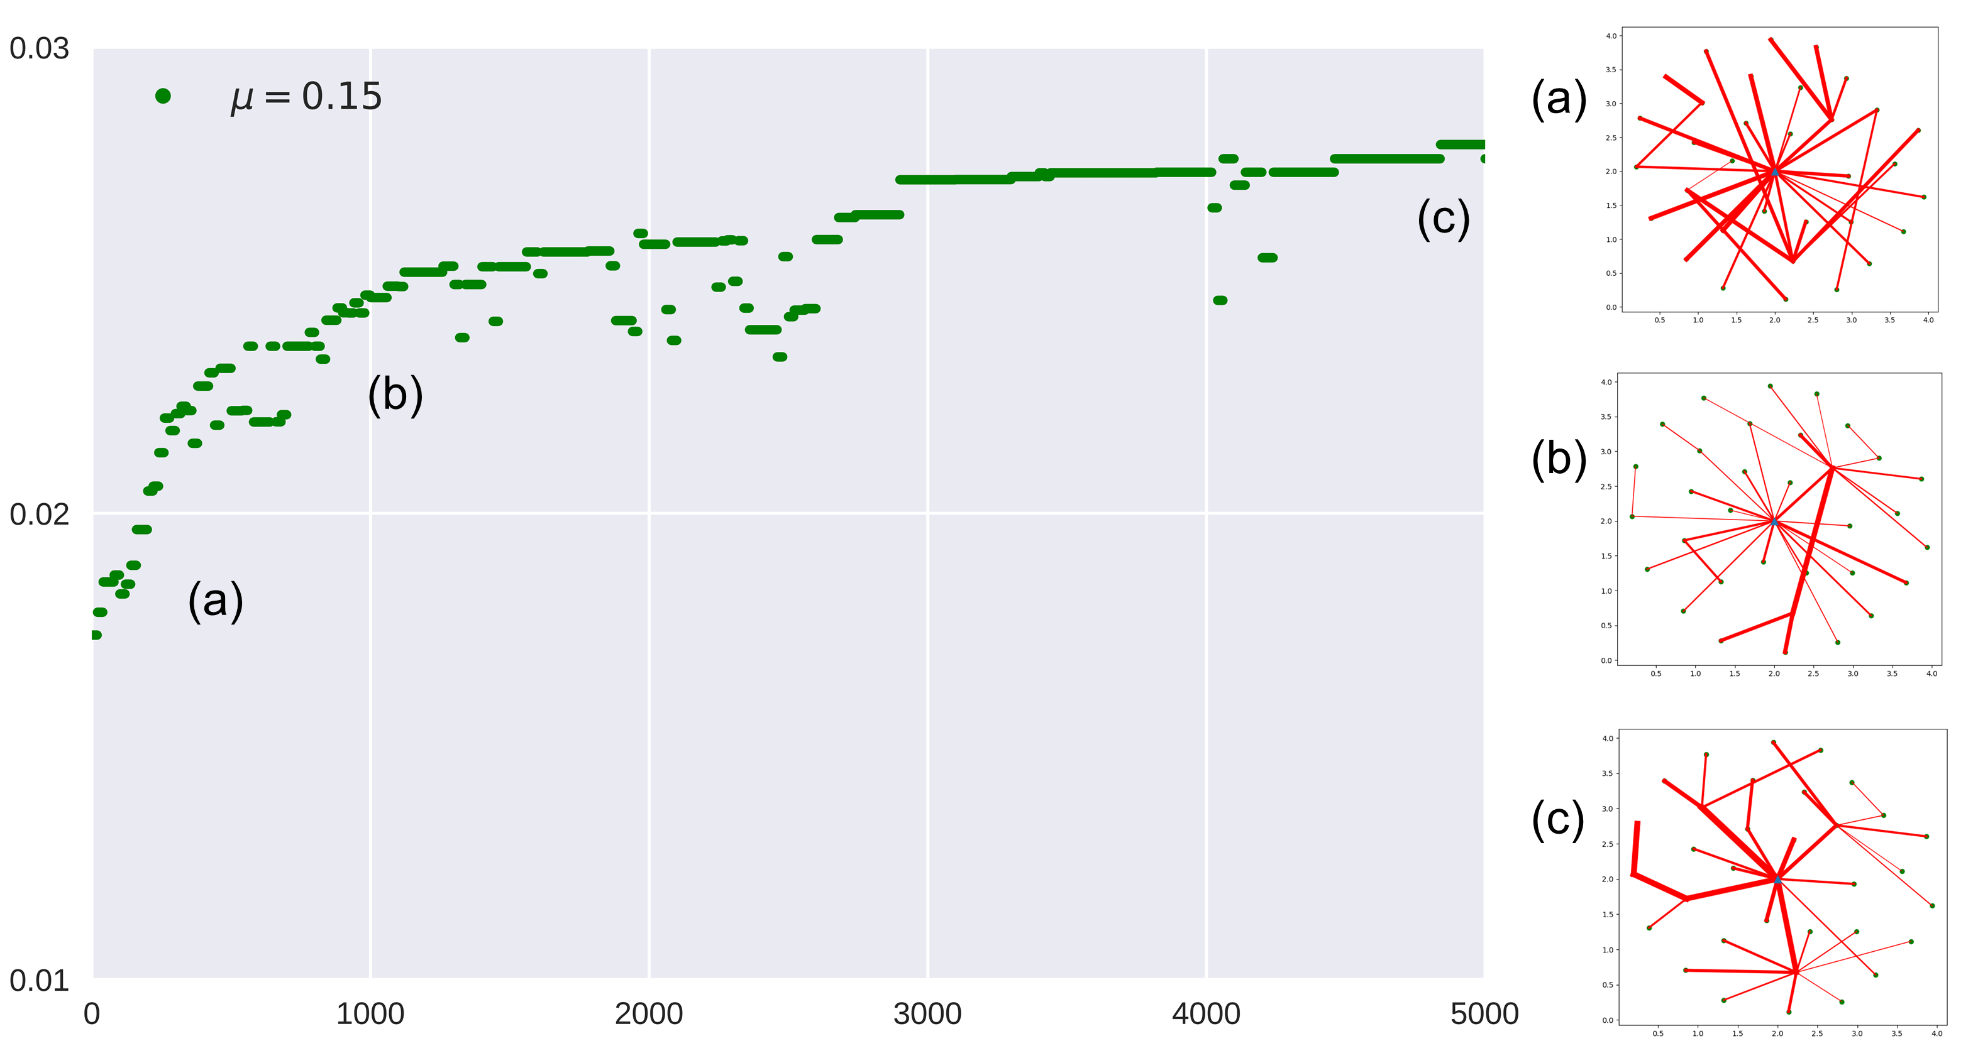
Virtual Vascular Network Optimization
Fitness
Generations

Slide 11
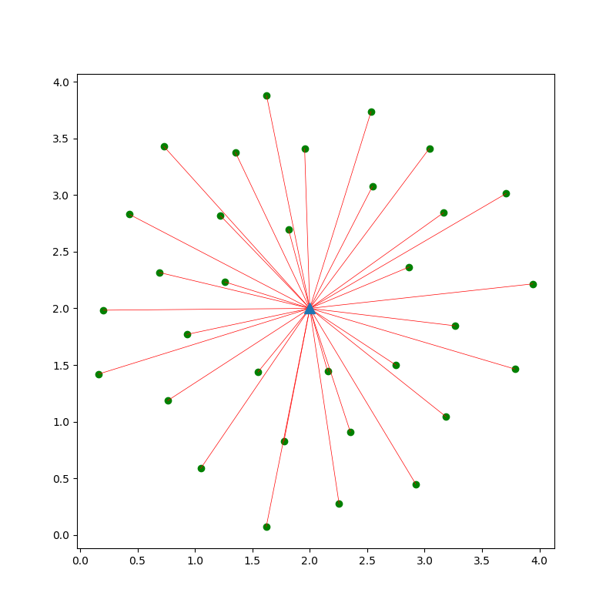
Theoretical Limits
Material cost
Dissipation or Resource Delivery

Slide 12
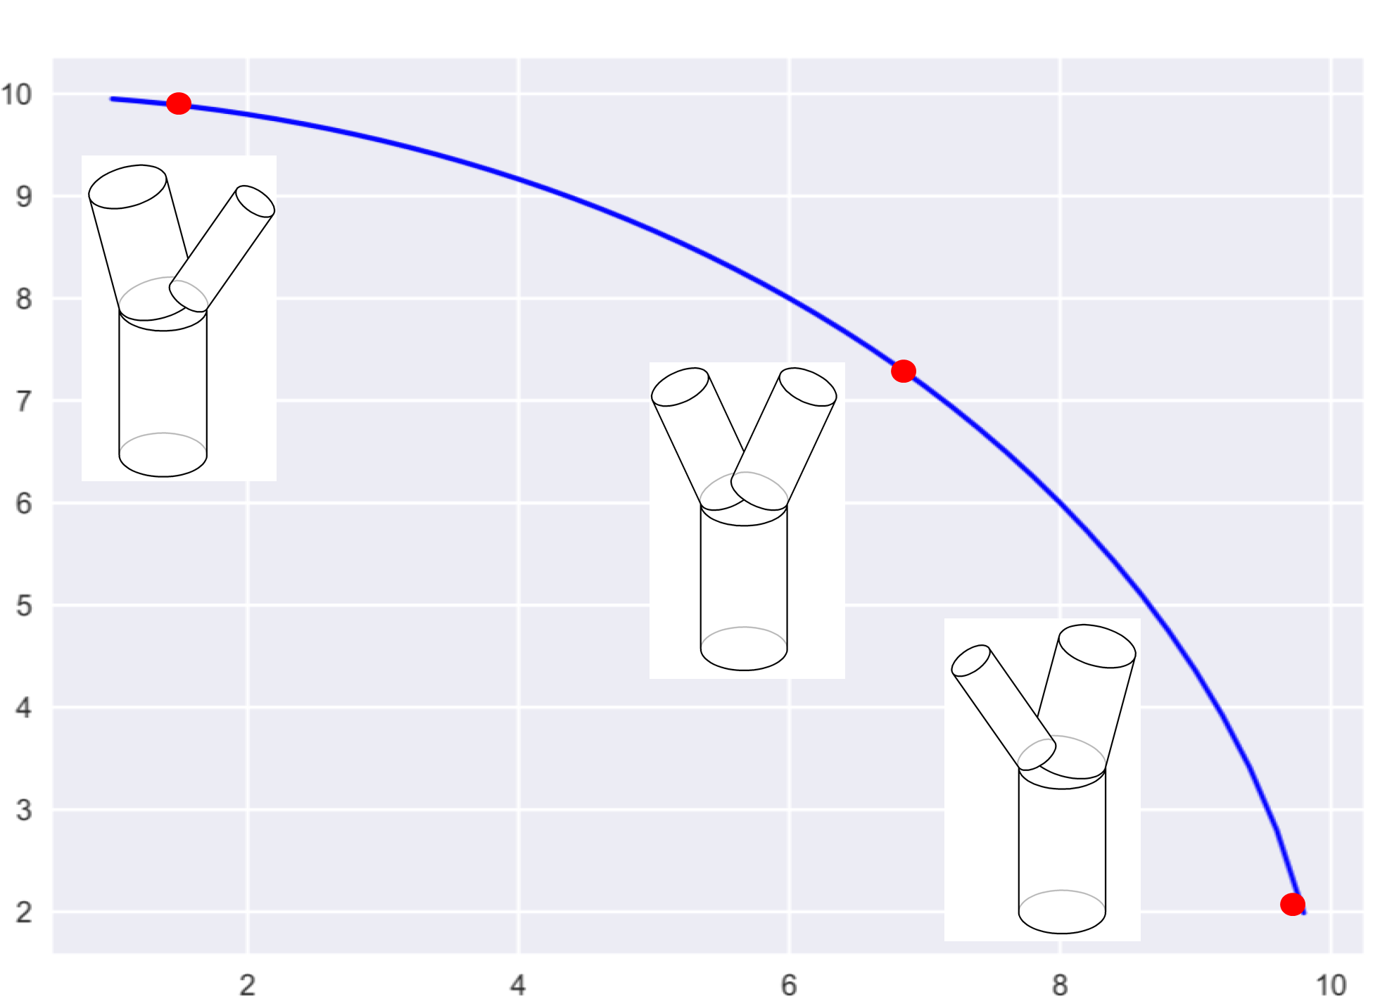
Theoretical Limits: Wave Reflection Minimization
Radius of child vessel C₂
Radius of child vessel C₁
Cross sectional area is preserved

Slide 13
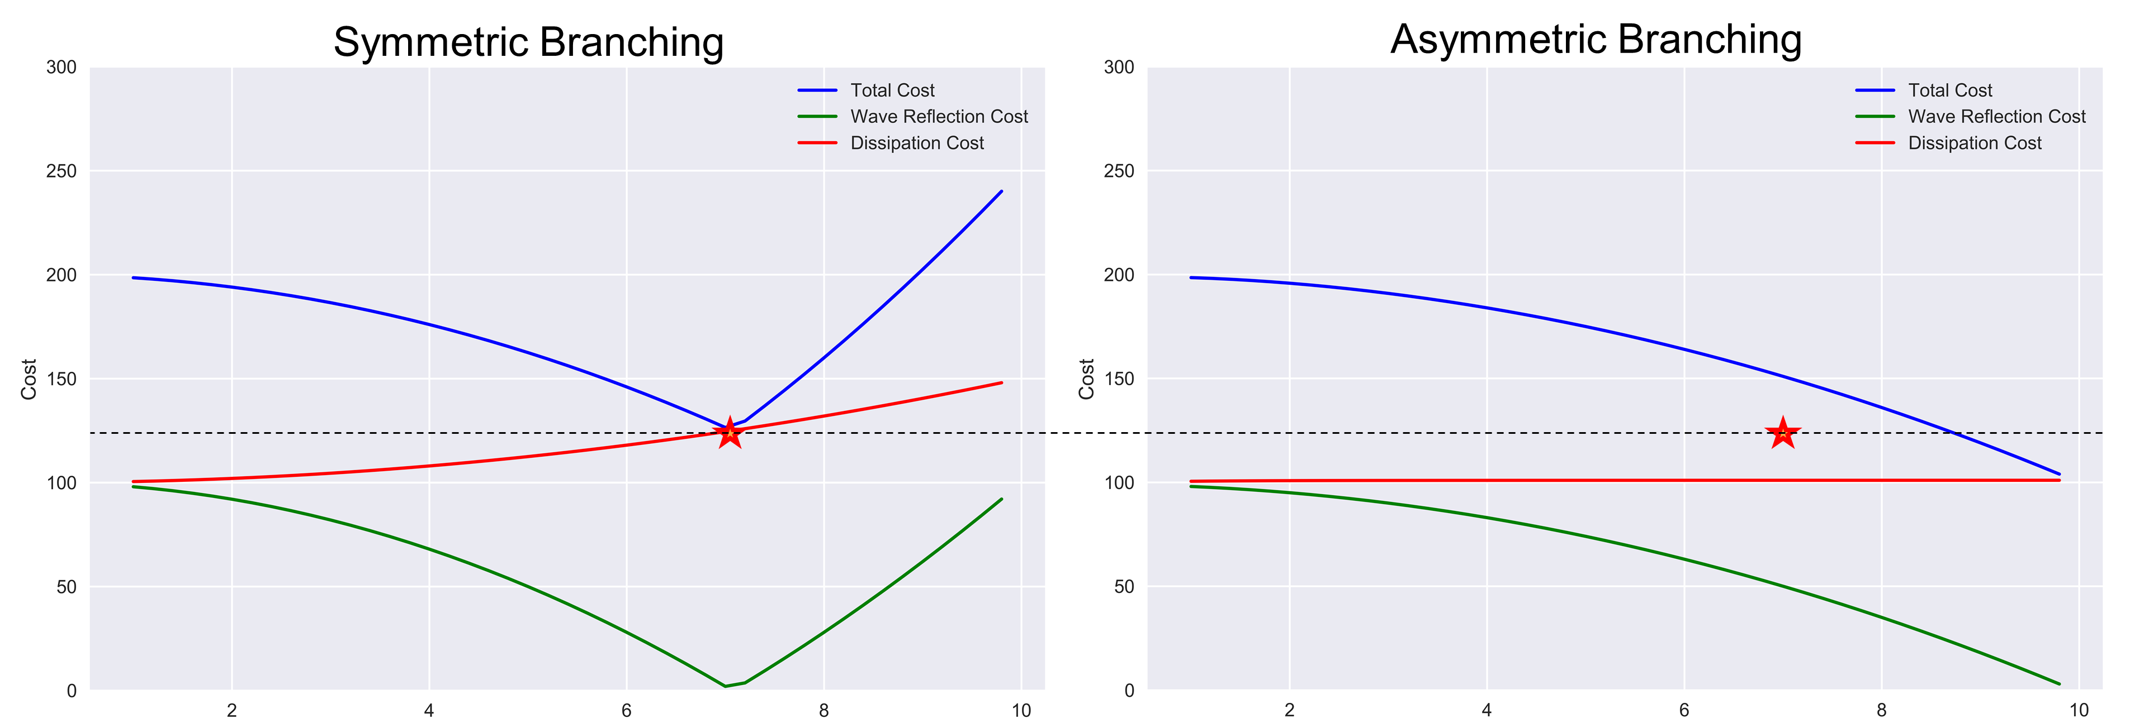
Theoretical Limits: Energy Loss Minimization
Both Dissipation and Wave Reflections
Radius of both child vessels C₁=C₂
Radius of child vessel C₁
Energy Loss Minimization favors Network Asymmetry

Slide 14
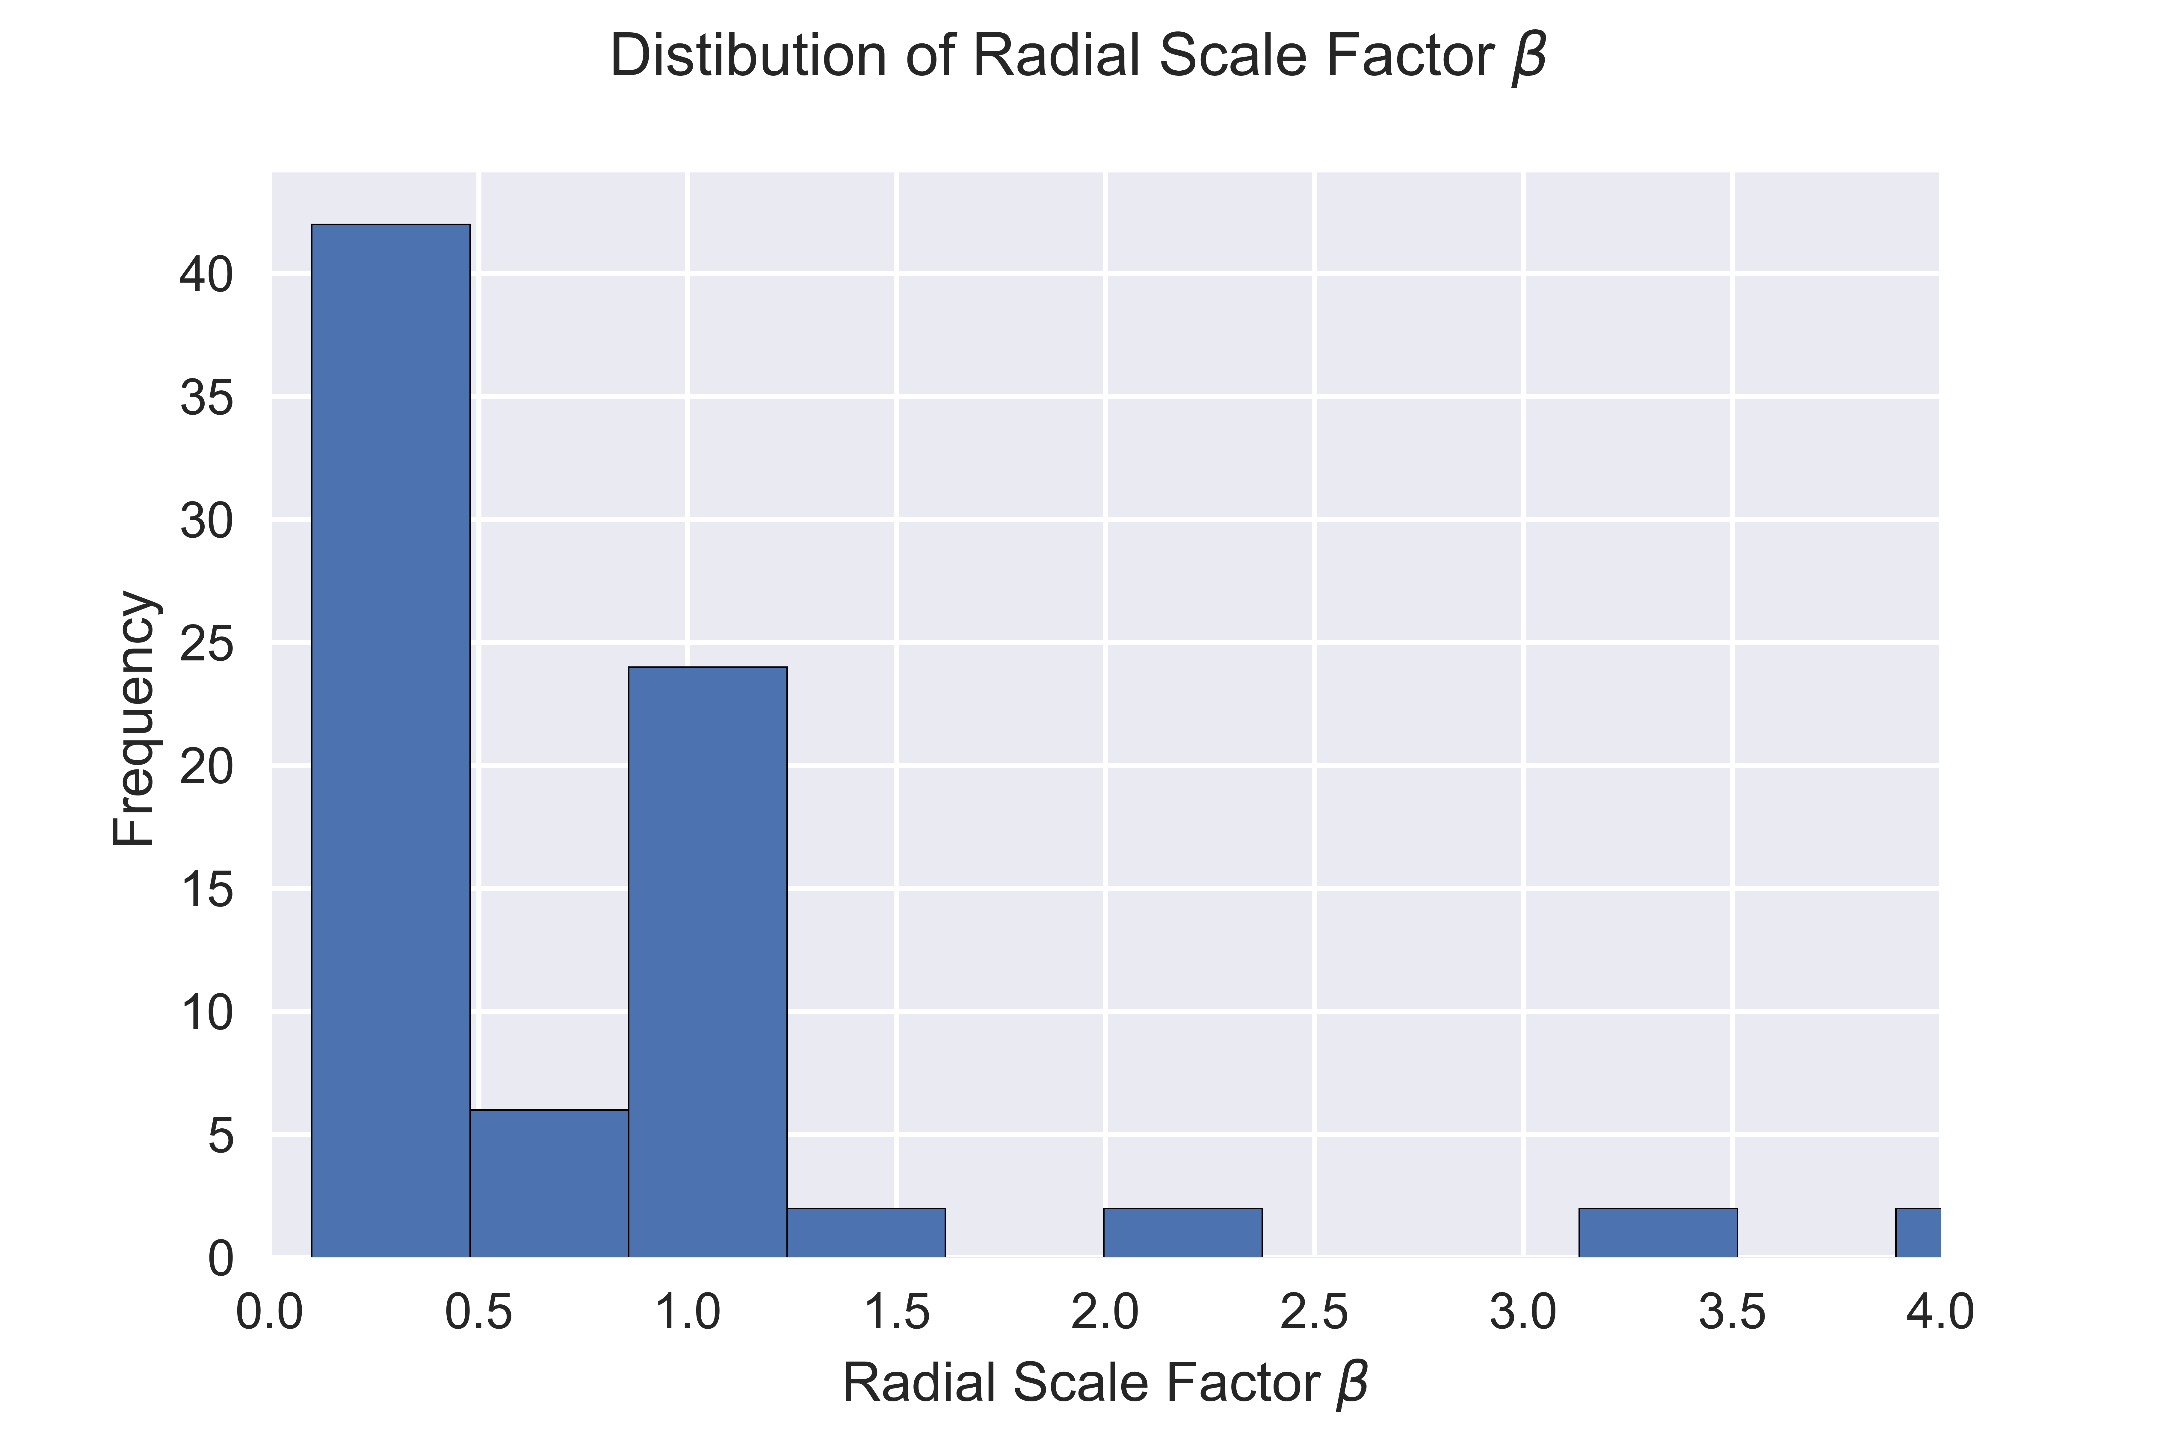
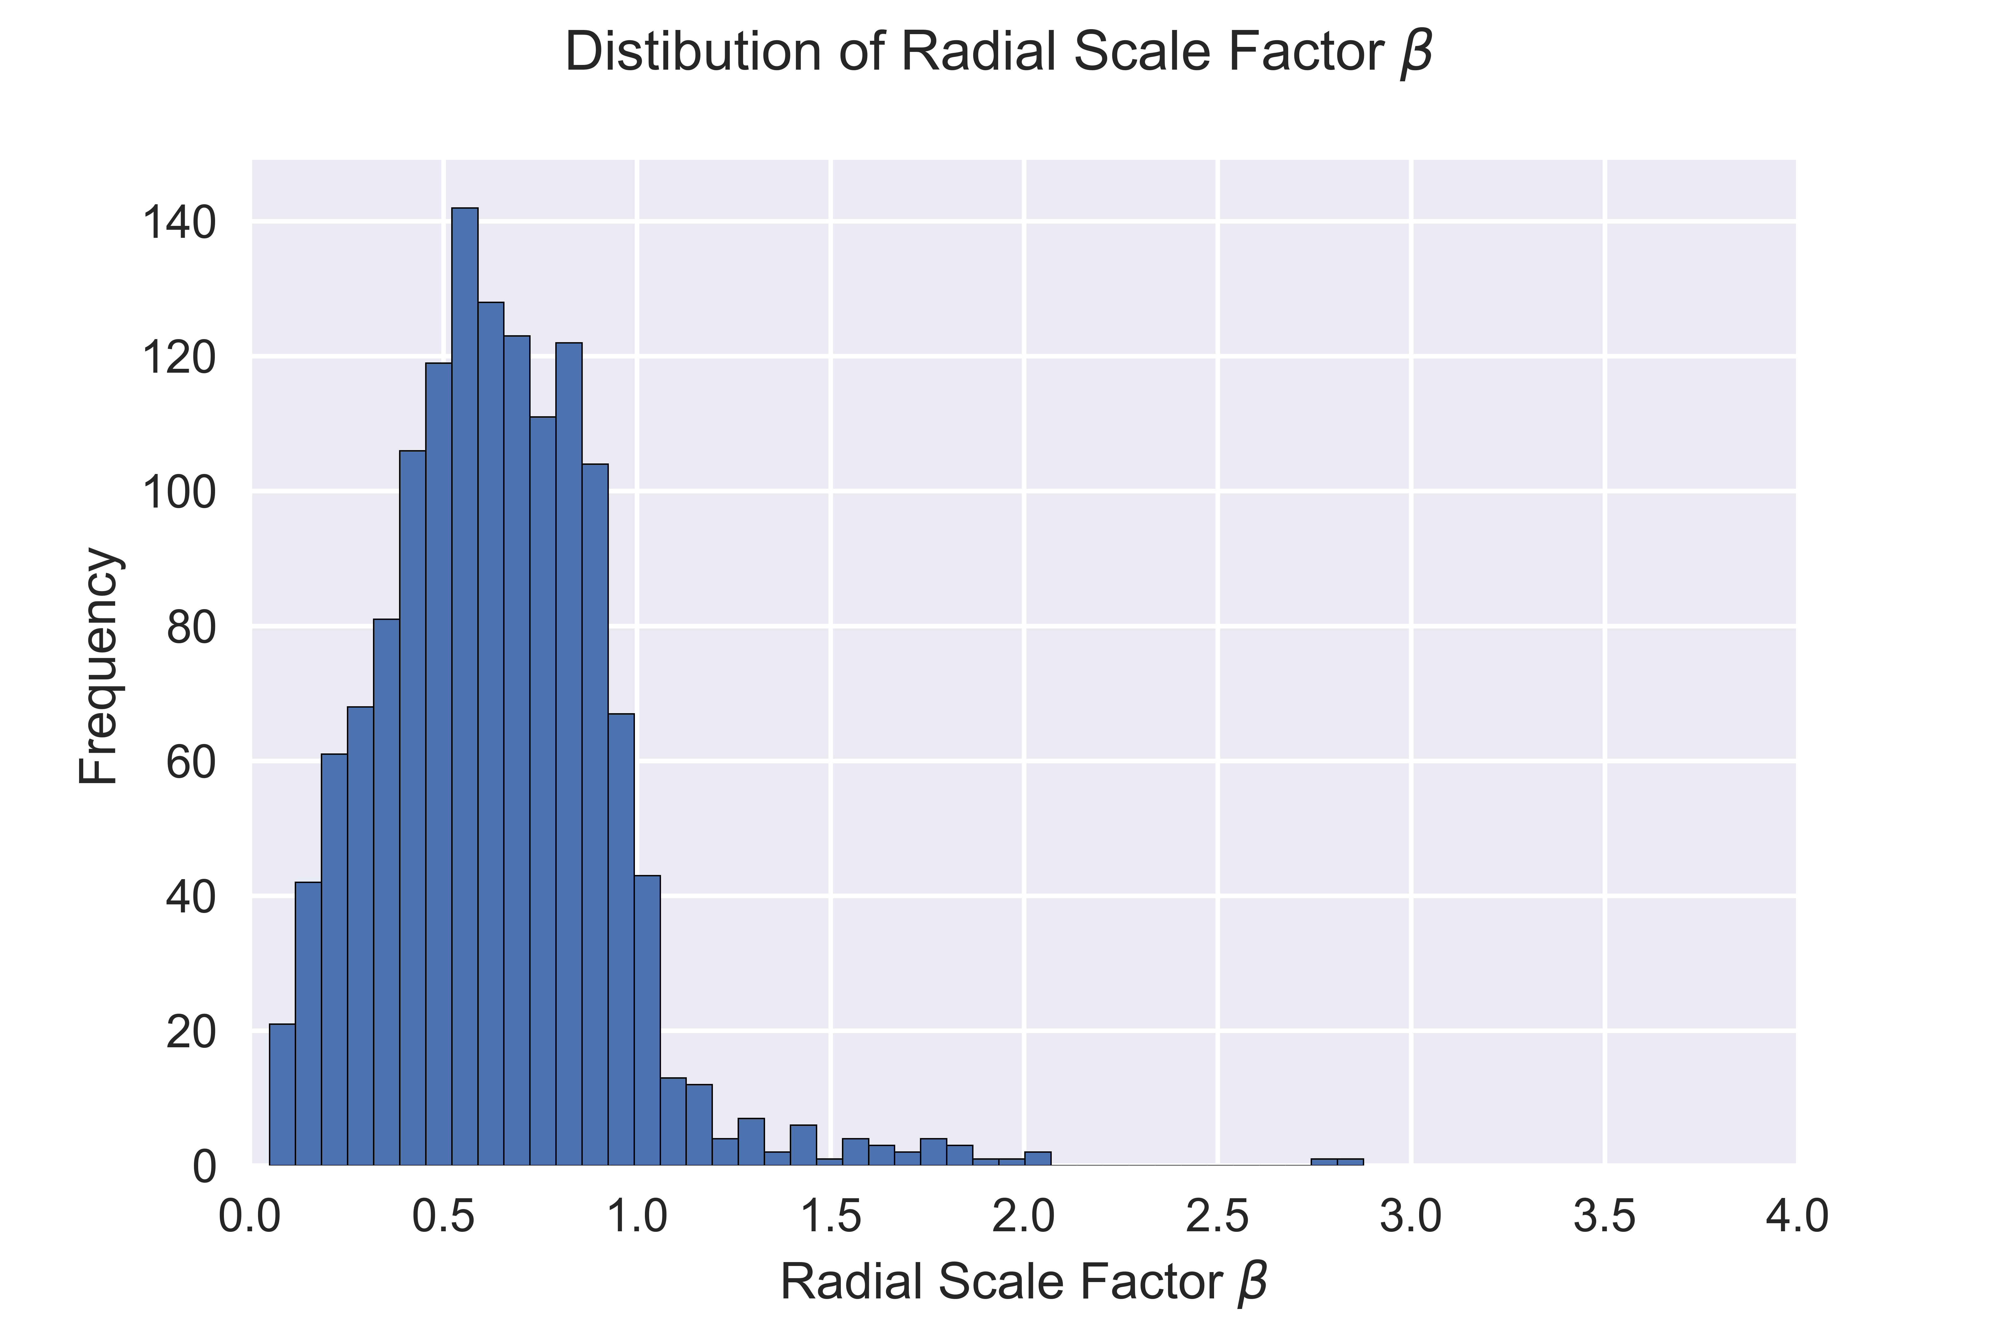
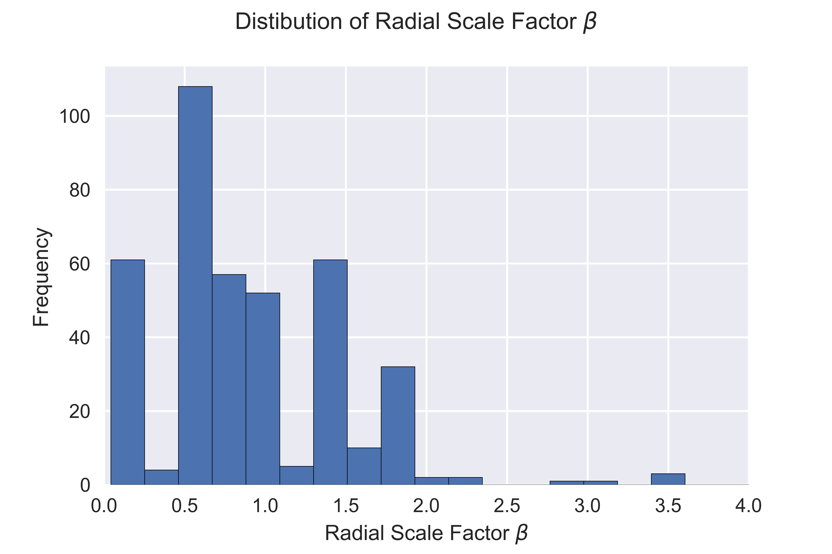
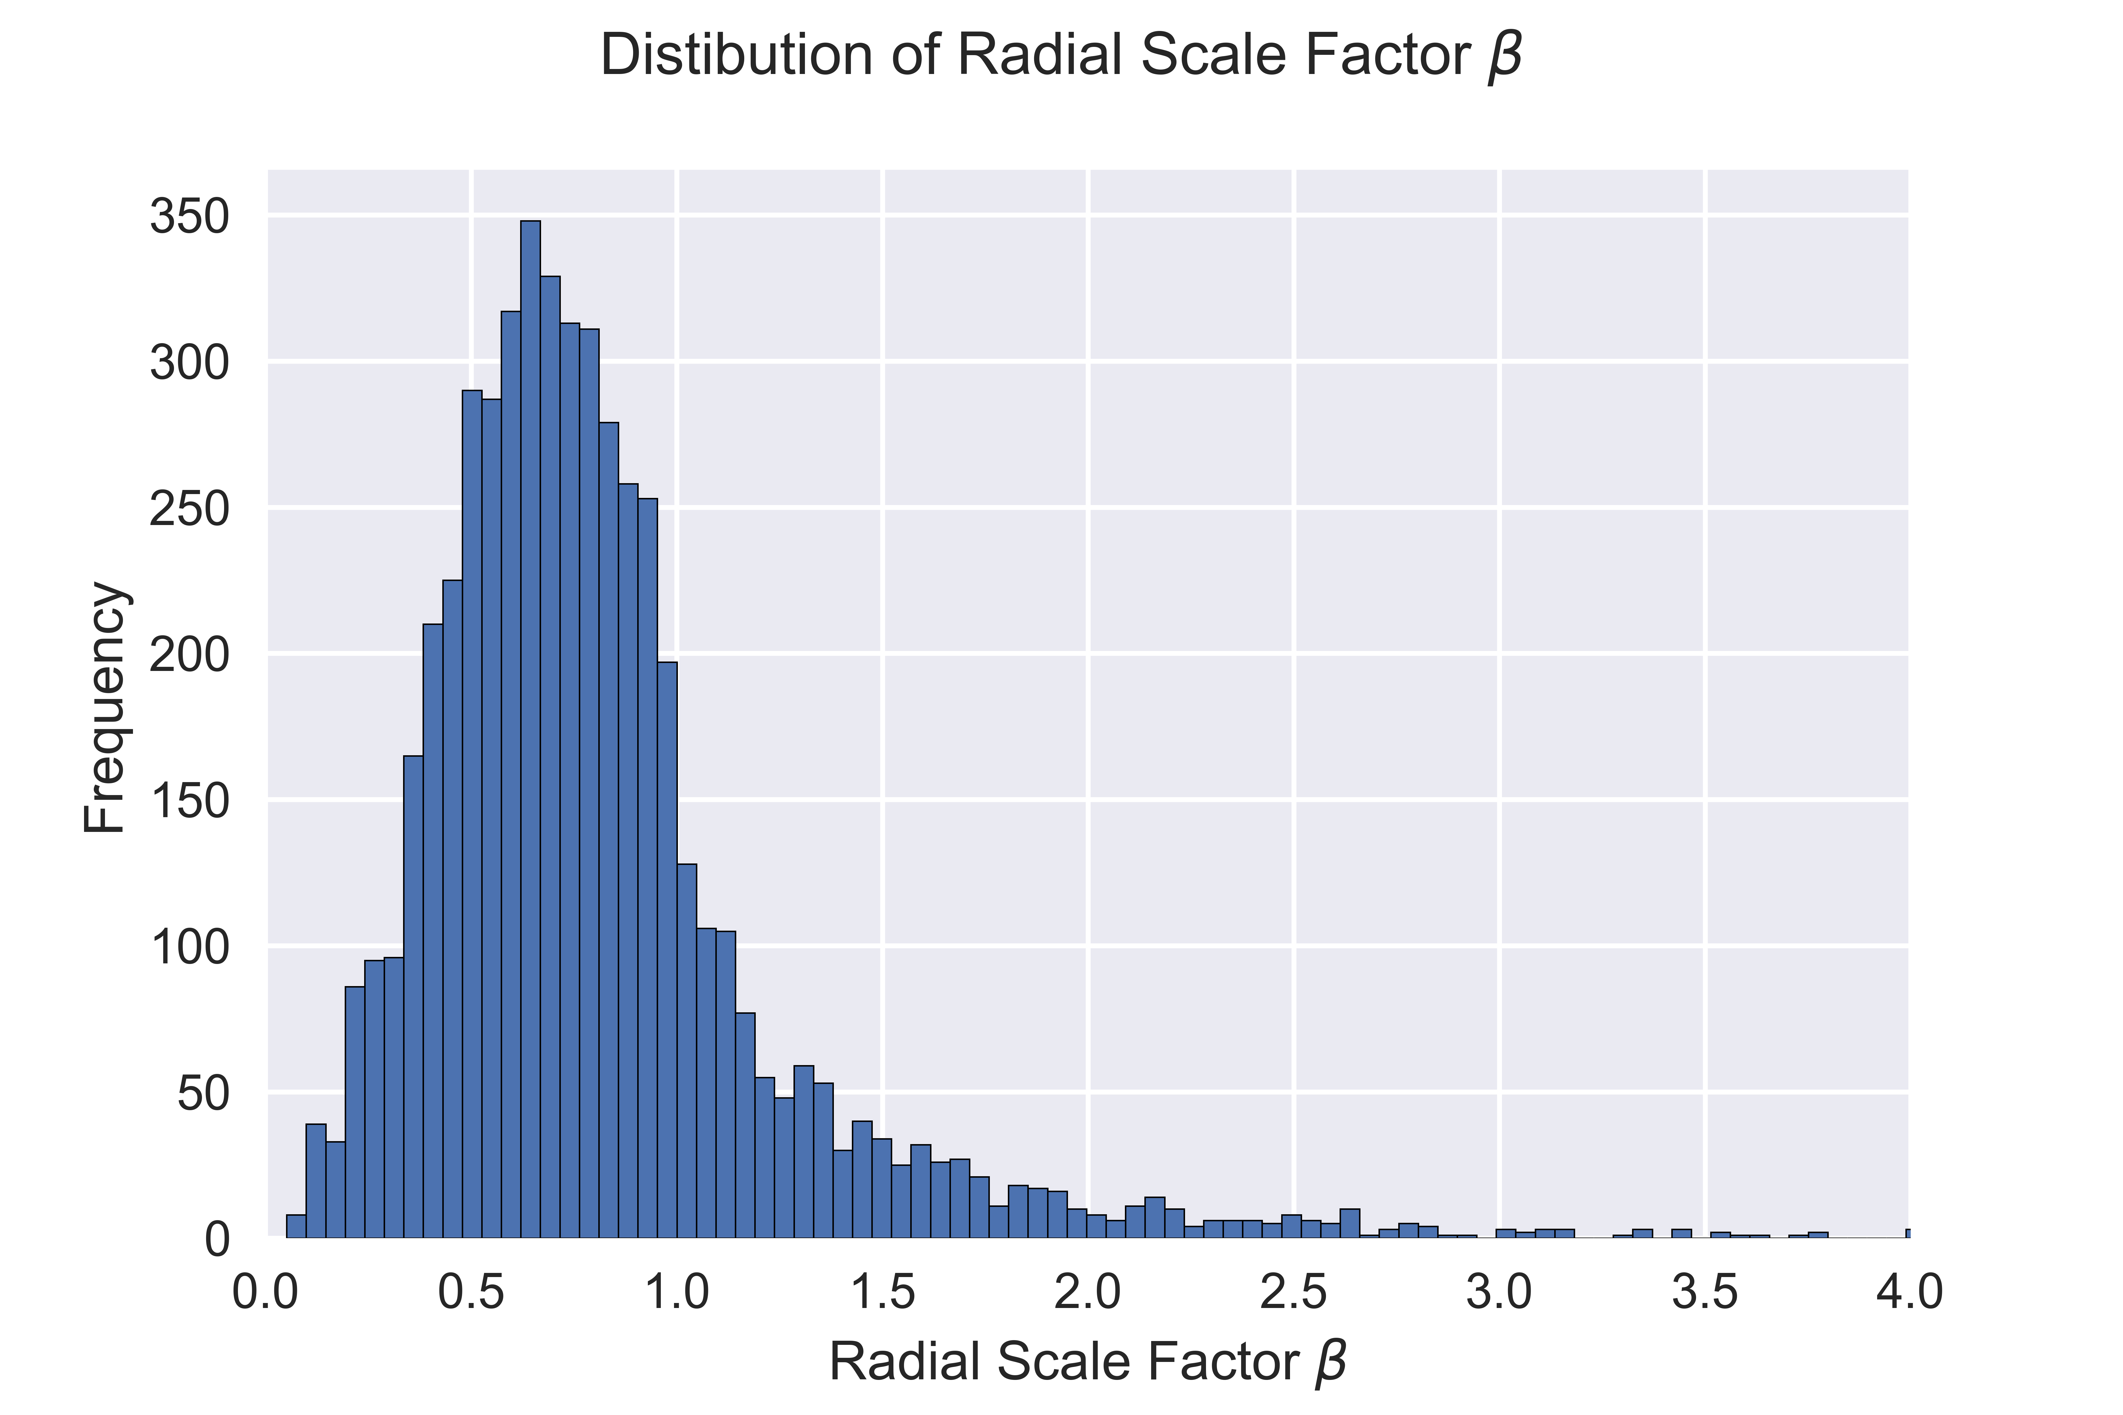
Network Comparisons: β distributions
Material cost + Energy Loss
Mammal
Plant
Material cost + Wave Reflections

Slide 15
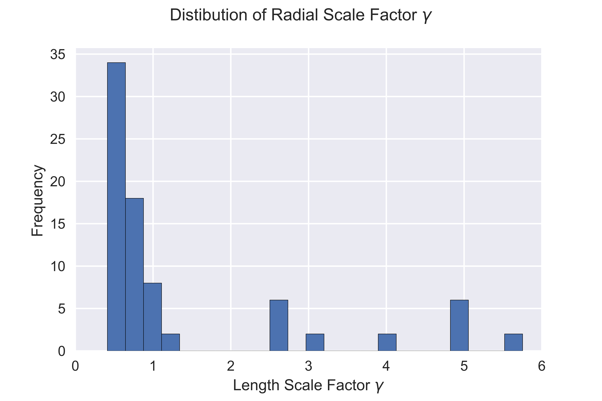
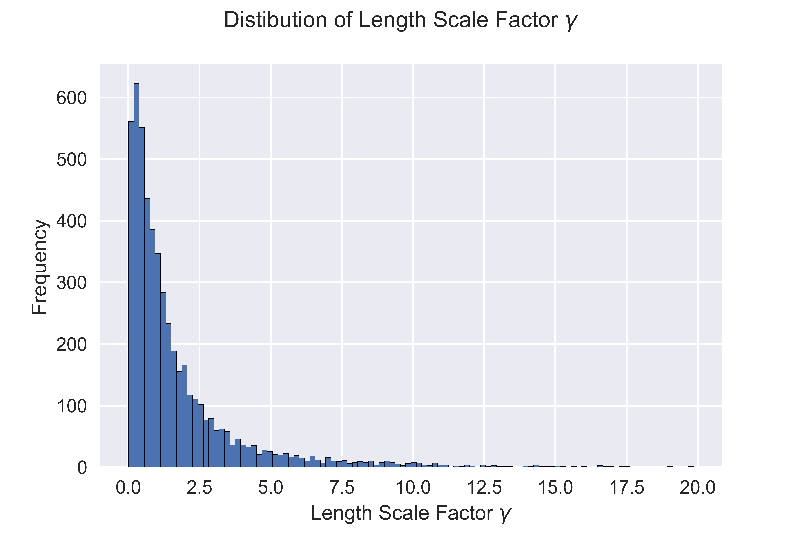
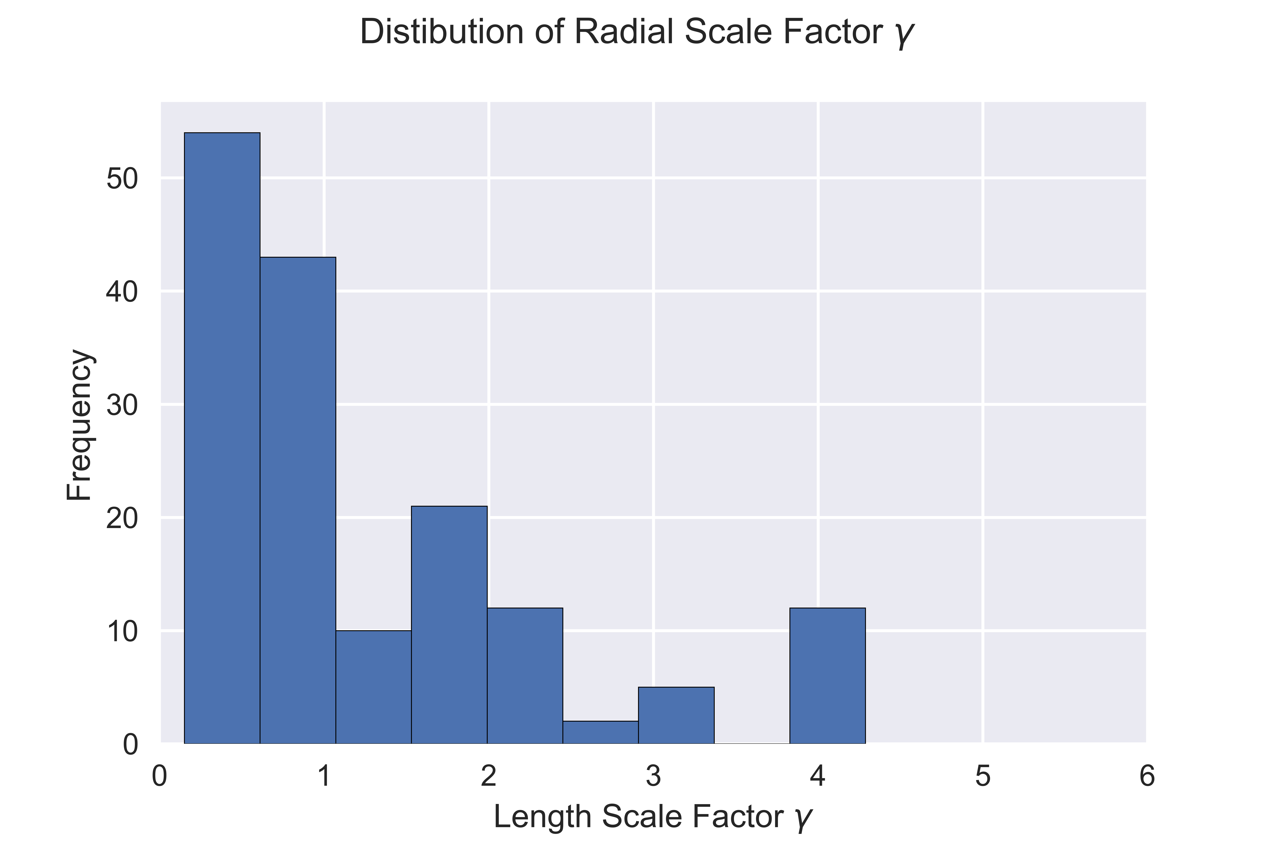
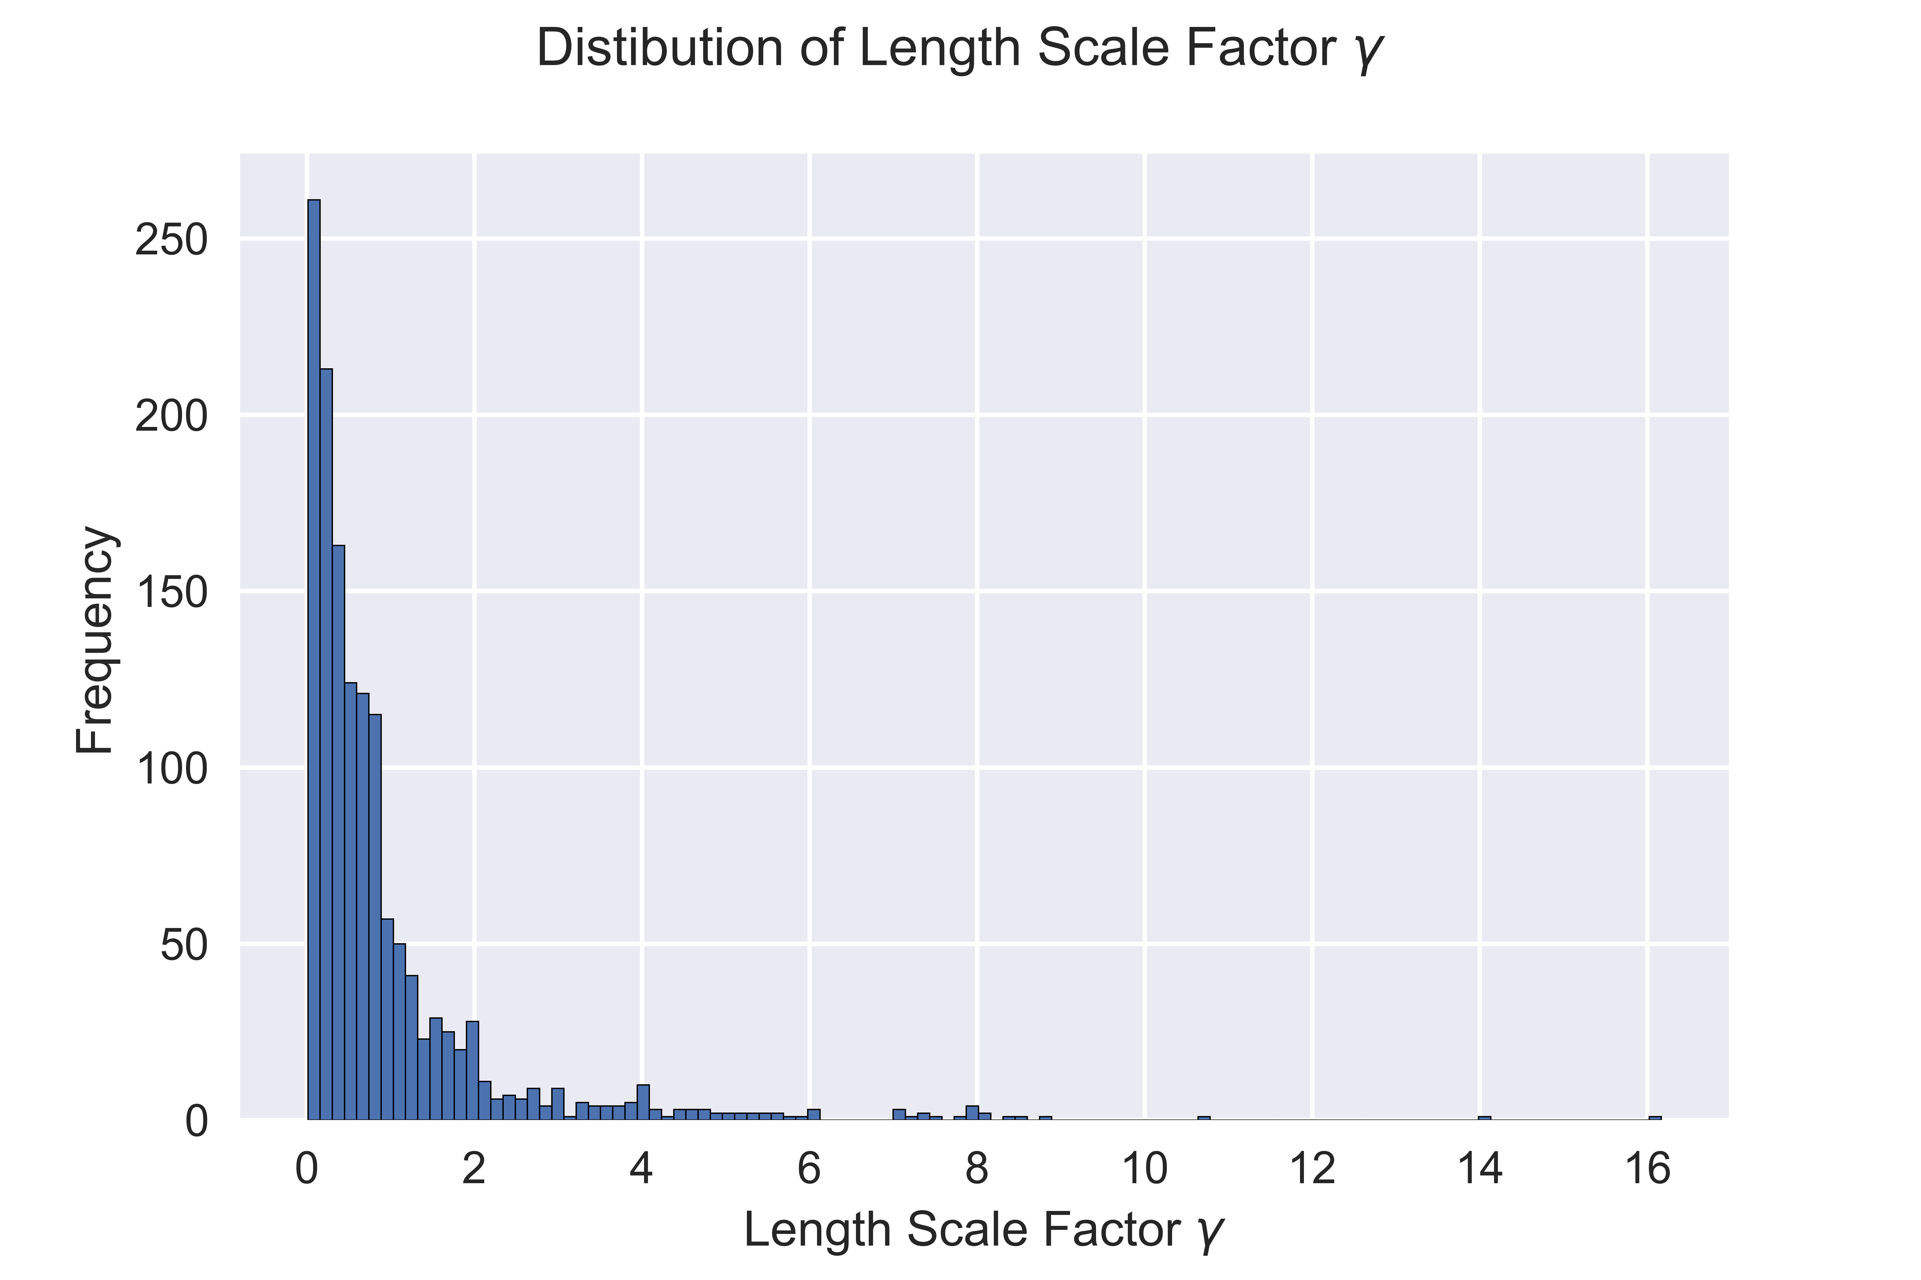
Network Comparisons: γ distributions
Material cost + Energy Loss
Mammal
Material cost + Wave Reflections
Plant

Slide 16


Conclusions
VVN Features | Mammal | Plant
Energy loss → Asymmetry
Wave Reflections → Symmetry and Asymmetry
Space filling + material cost →Long-tail γ distribution

